Slide 1
Lab 3
Scanner class

Slide 2
Scanner class
Scanner class in Java is found in the java.util package. Java provides various ways to read input from the keyboard, the java.util.Scanner class is one of them.
The Java Scanner class breaks the input into tokens using a delimiter which is whitespace by default. It provides many methods to read and parse various primitive values.
The Java Scanner class is widely used to parse text for strings and primitive types using a regular expression.
It is the simplest way to get input in Java.
By the help of Scanner in Java, we can get input from the user in primitive types such as int, long, double, byte, float, short, etc.
The Java Scanner class extends Object class

Slide 3
The Java Scanner class provides nextXXX() methods to return the type of value such as nextInt(), nextByte(), nextShort(), next(), nextLine(), nextDouble(), nextFloat(), nextBoolean(), etc.
To get a single character from the scanner, you can call next().charAt(0) method which returns a single character.

Slide 4
How to get Java Scanner
To get the instance of Java Scanner which reads input from the user, we need to pass the input stream (System.in) in the constructor of Scanner class. For Example:
Scanner in = new Scanner(System.in);

Slide 5
import java.util.Scanner; // Import the Scanner class class MyClass { public static void main(String[] args) { Scanner myObj = new Scanner(System.in); // Create a Scanner object System.out.println("Enter username"); String userName = myObj.nextLine(); // Read user input System.out.println("Username is: " + userName); // Output user input } }

Slide 6
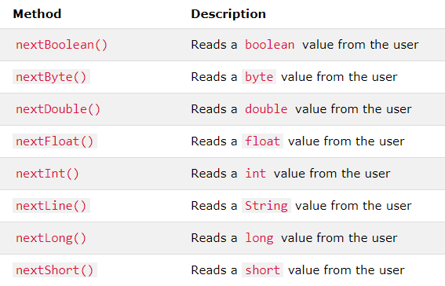
Input Types

Slide 7
Example
import java.util.Scanner; class MyClass { public static void main(String[] args) { Scanner myObj = new Scanner(System.in); System.out.println("Enter name, age and salary"); // String input String name = myObj.nextLine(); // Numerical input int age = myObj.nextInt(); double salary = myObj.nextDouble(); // Output input by user System.out.println("Name: " + name); System.out.println("Age: " + age); System.out.println("Salary: " + salary); } }

Slide 8
Java for-each Loop (Enhanced for Loop)
Java, there is another form of for loop (in addition to standard for loop) to work with arrays and collection, the enhanced for loop.
If you are working with arrays and collections, you can use alternative syntax of for loop (enhanced form of for loop) to iterate through items of arrays/collections. It is also referred as for-each loop because the loop iterates through each element of array/collection.

Slide 9
Syntax of for-each loop
for(data_type item : collection)
{ ... }
In the above syntax,
collection is a collection or array variable which you have to loop through.
item is a single item from the collection.

Slide 10
How for-each loop works?
Here's how the enhanced for loop works. For each iteration, for-each loop
iterates through each item in the given collection or array (collection),
stores each item in a variable (item)
and executes the body of the loop.

Slide 11
Example
class EnhancedForLoop {
public static void main(String[] args) {
int[] numbers = {3, 4, 5, -5, 0, 12};
int sum = 0;
for (int number: numbers) {
sum += number;
}
System.out.println("Sum = " + sum);
}
}

Slide 12
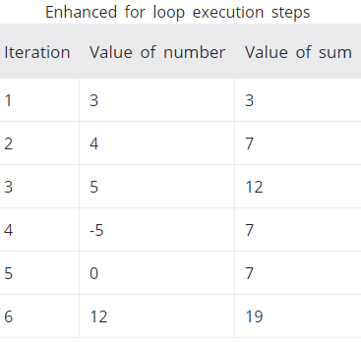
execution of foreach loop

Slide 13
You can see during each iteration, the for each loop
iterates through each element in the numbers variable
stores it in the number variable
and executes the body, i.e. adds number to sum

Slide 14
Random Generator
nextInt() method of Random class is used to generate random number
import java.util.*;
class GenerateRandomNumber {
public static void main(String[] args) {
int counter;
Random rnum = new Random();
System.out.println("Random Numbers:");
System.out.println("***************");
for (counter = 1; counter <= 5; counter++) {
System.out.println(rnum.nextInt(200));
}
}
}

